Slide 1
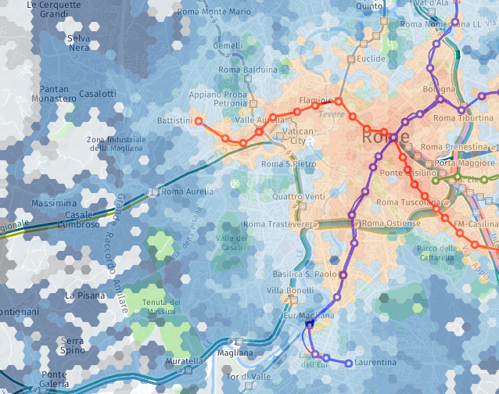
CityChrone: an interactive platform for transport network analysis and planning in urban systems
Indaco Biazzo, Politecnico di Torino
www.citychrone.org

Slide 2
Measure the performance of public transports in urban systems
Complex systems
Data: Transports data, street networks, Population density.
Measures: Universal, Transparent, meaningful, reproducible.
Help stakeholders, citizens, etc. in decision process.
Video…

Slide 3
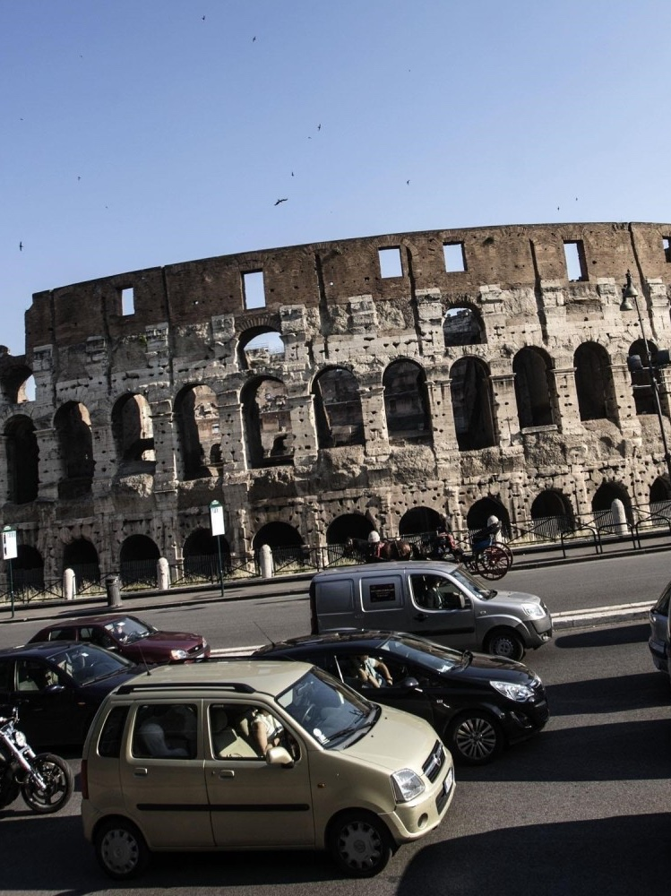
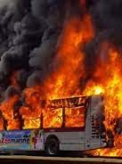
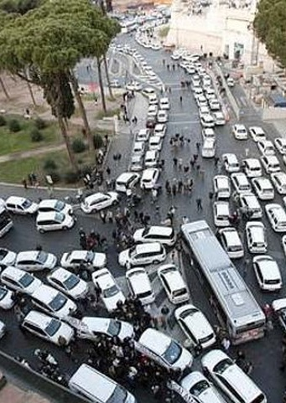
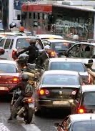
Real Motivation
I was born in Rome, I had a difficult childhood.
How much it suck with respect the rest of the word?

Slide 4
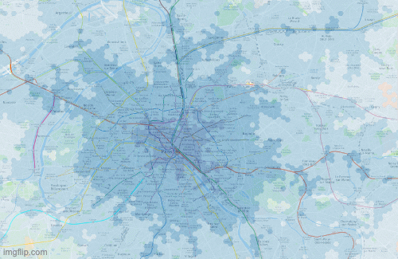
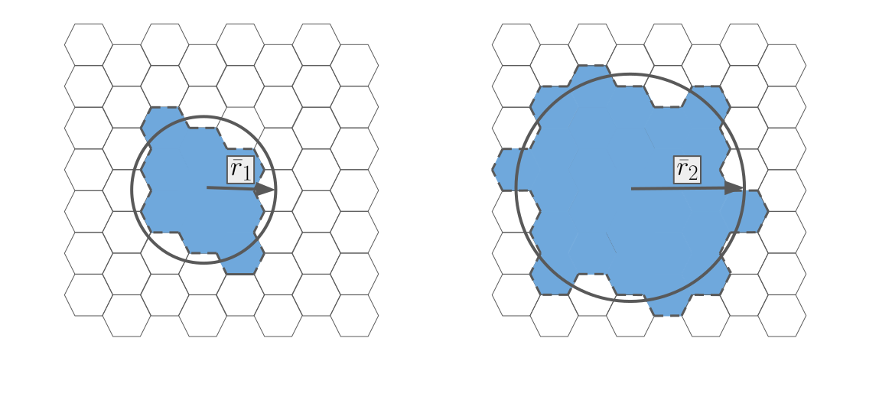
How to measure public transports performances?
Isochrones
First step towards an accessibility measure:
The larger isochrones are, the faster you move.

Slide 5
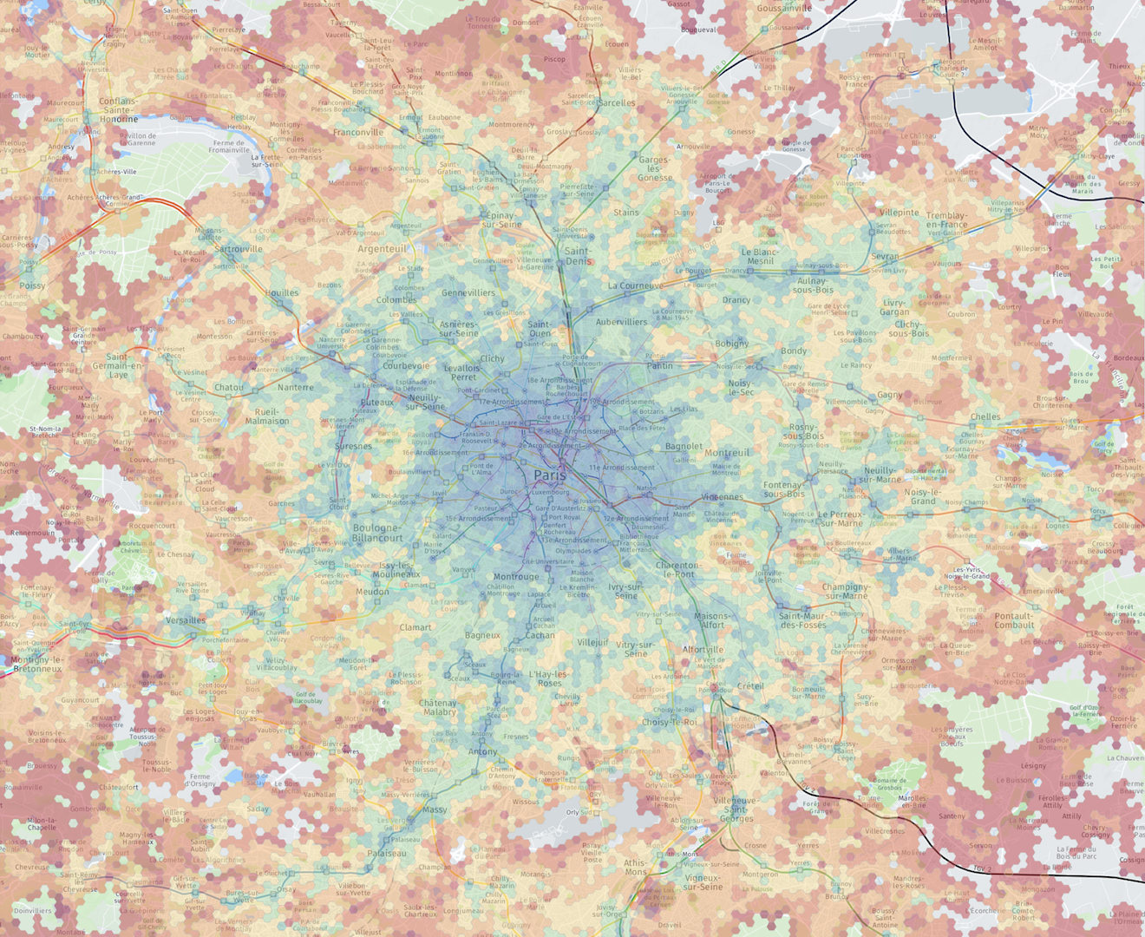
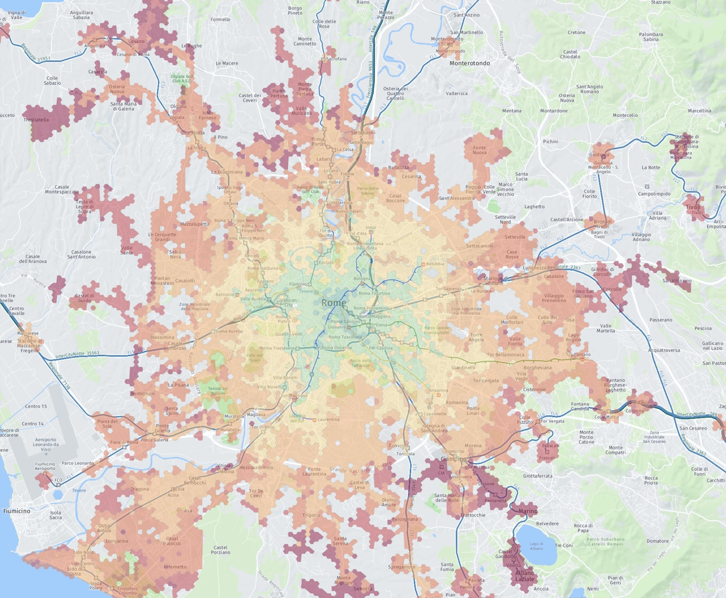
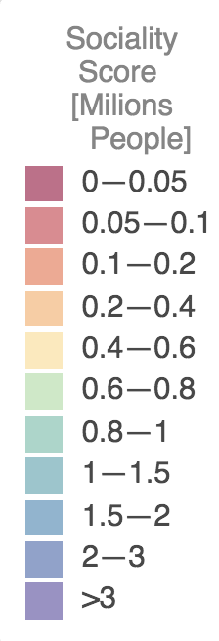
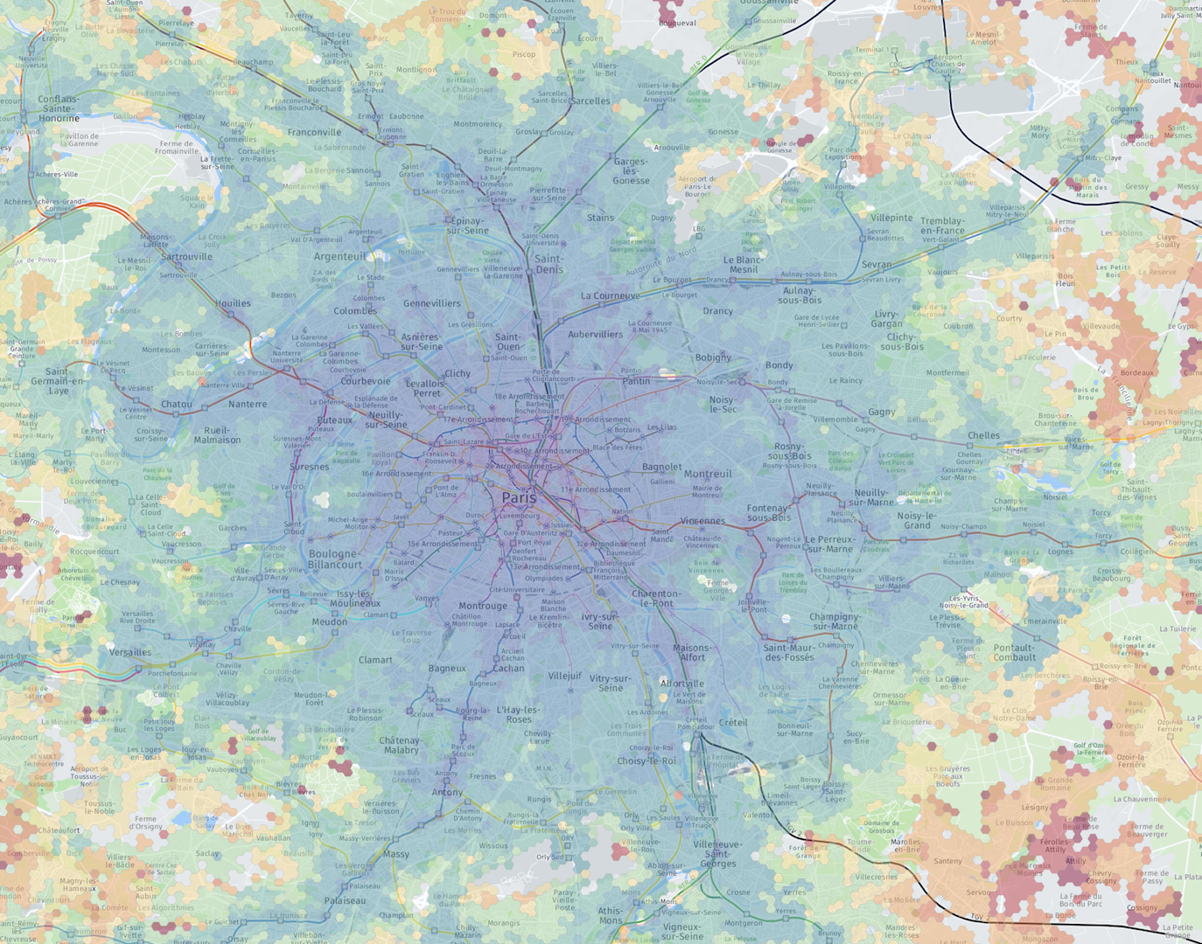
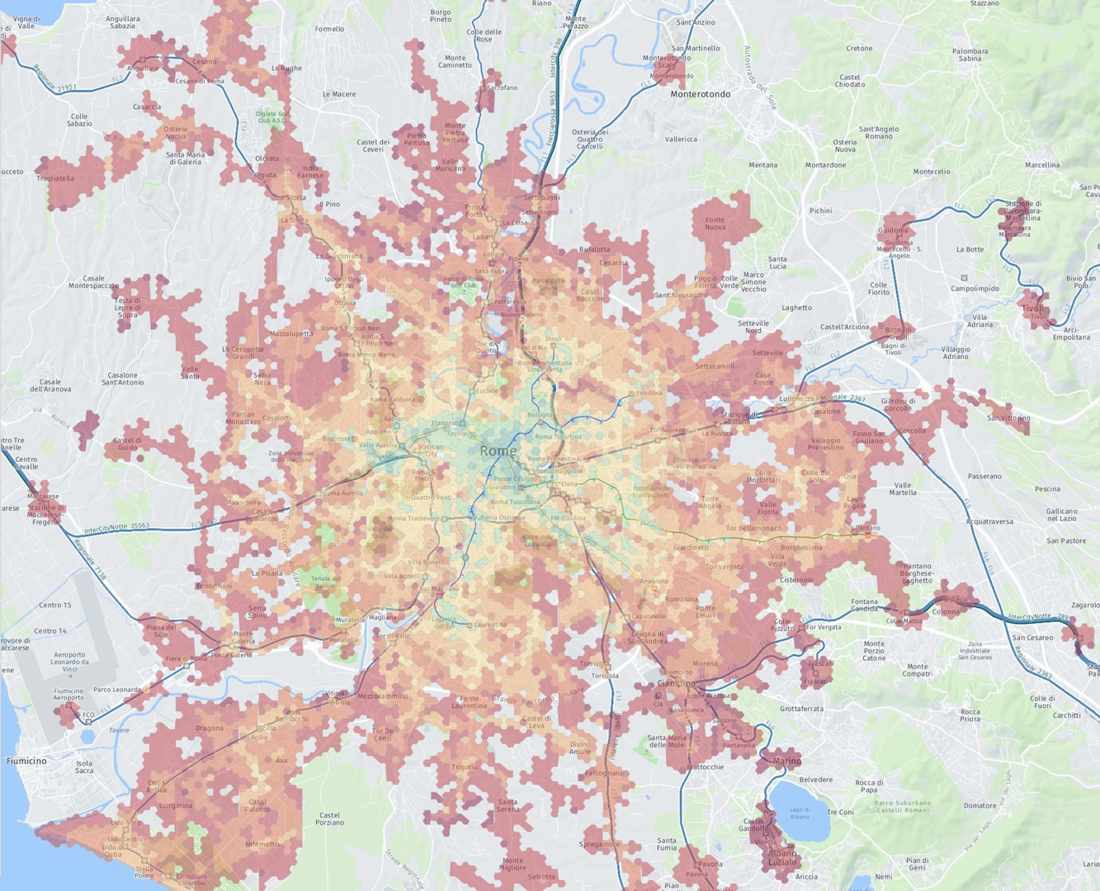
Velocity and Sociality score
Paris
Rome
Biazzo, I., Monechi, B., & Loreto, V. (2019). General scores for accessibility and inequality measures in urban areas. Royal Society open science, 6(8), 190979.

Slide 6
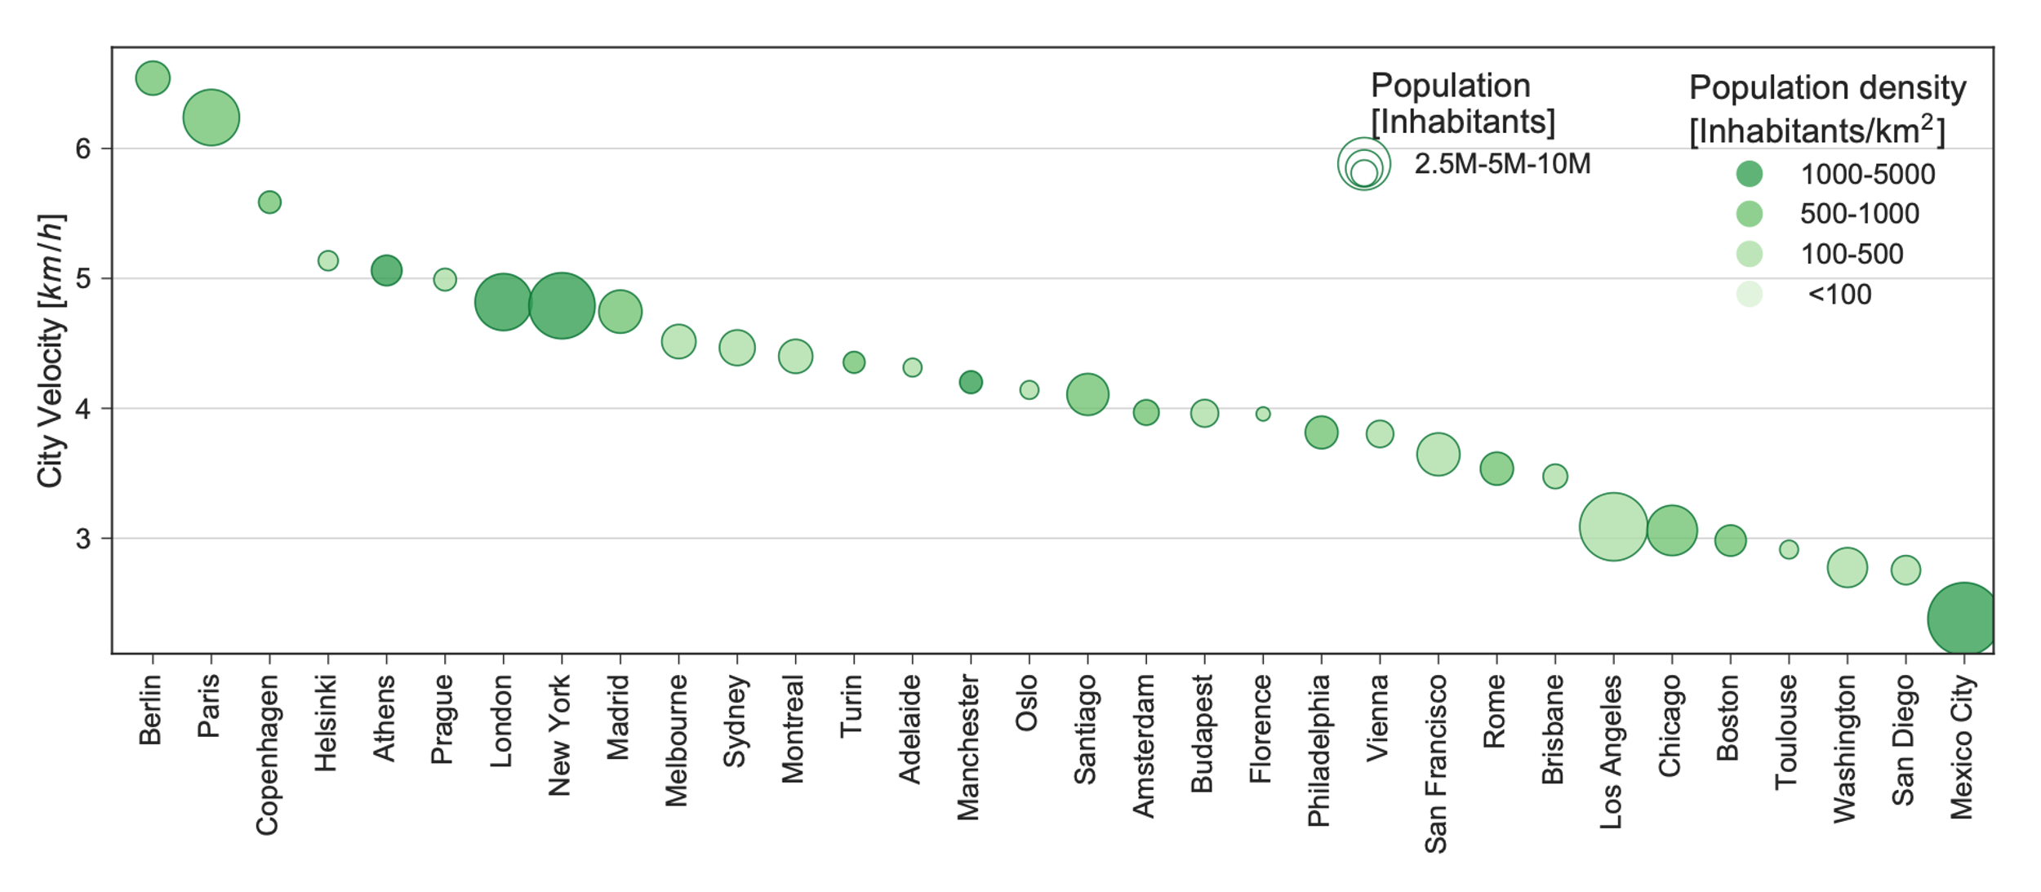
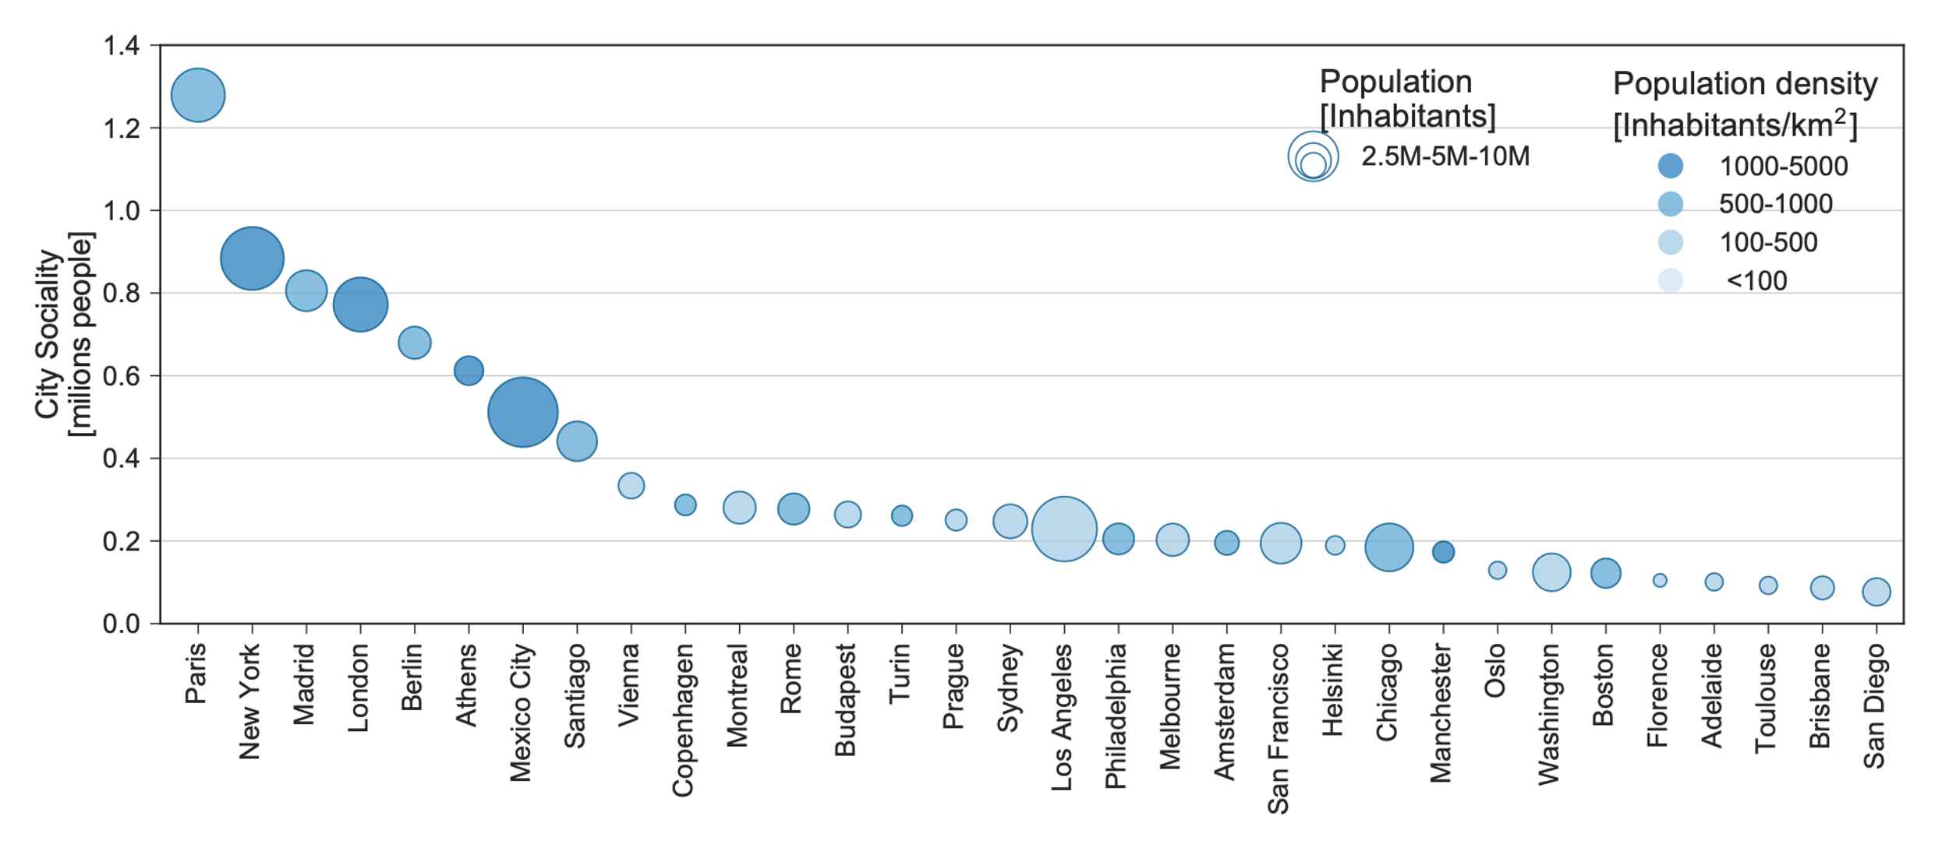
Rankings
Biazzo, I., Monechi, B., & Loreto, V. (2019). General scores for accessibility and inequality measures in urban areas. Royal Society open science, 6(8), 190979.

Slide 7
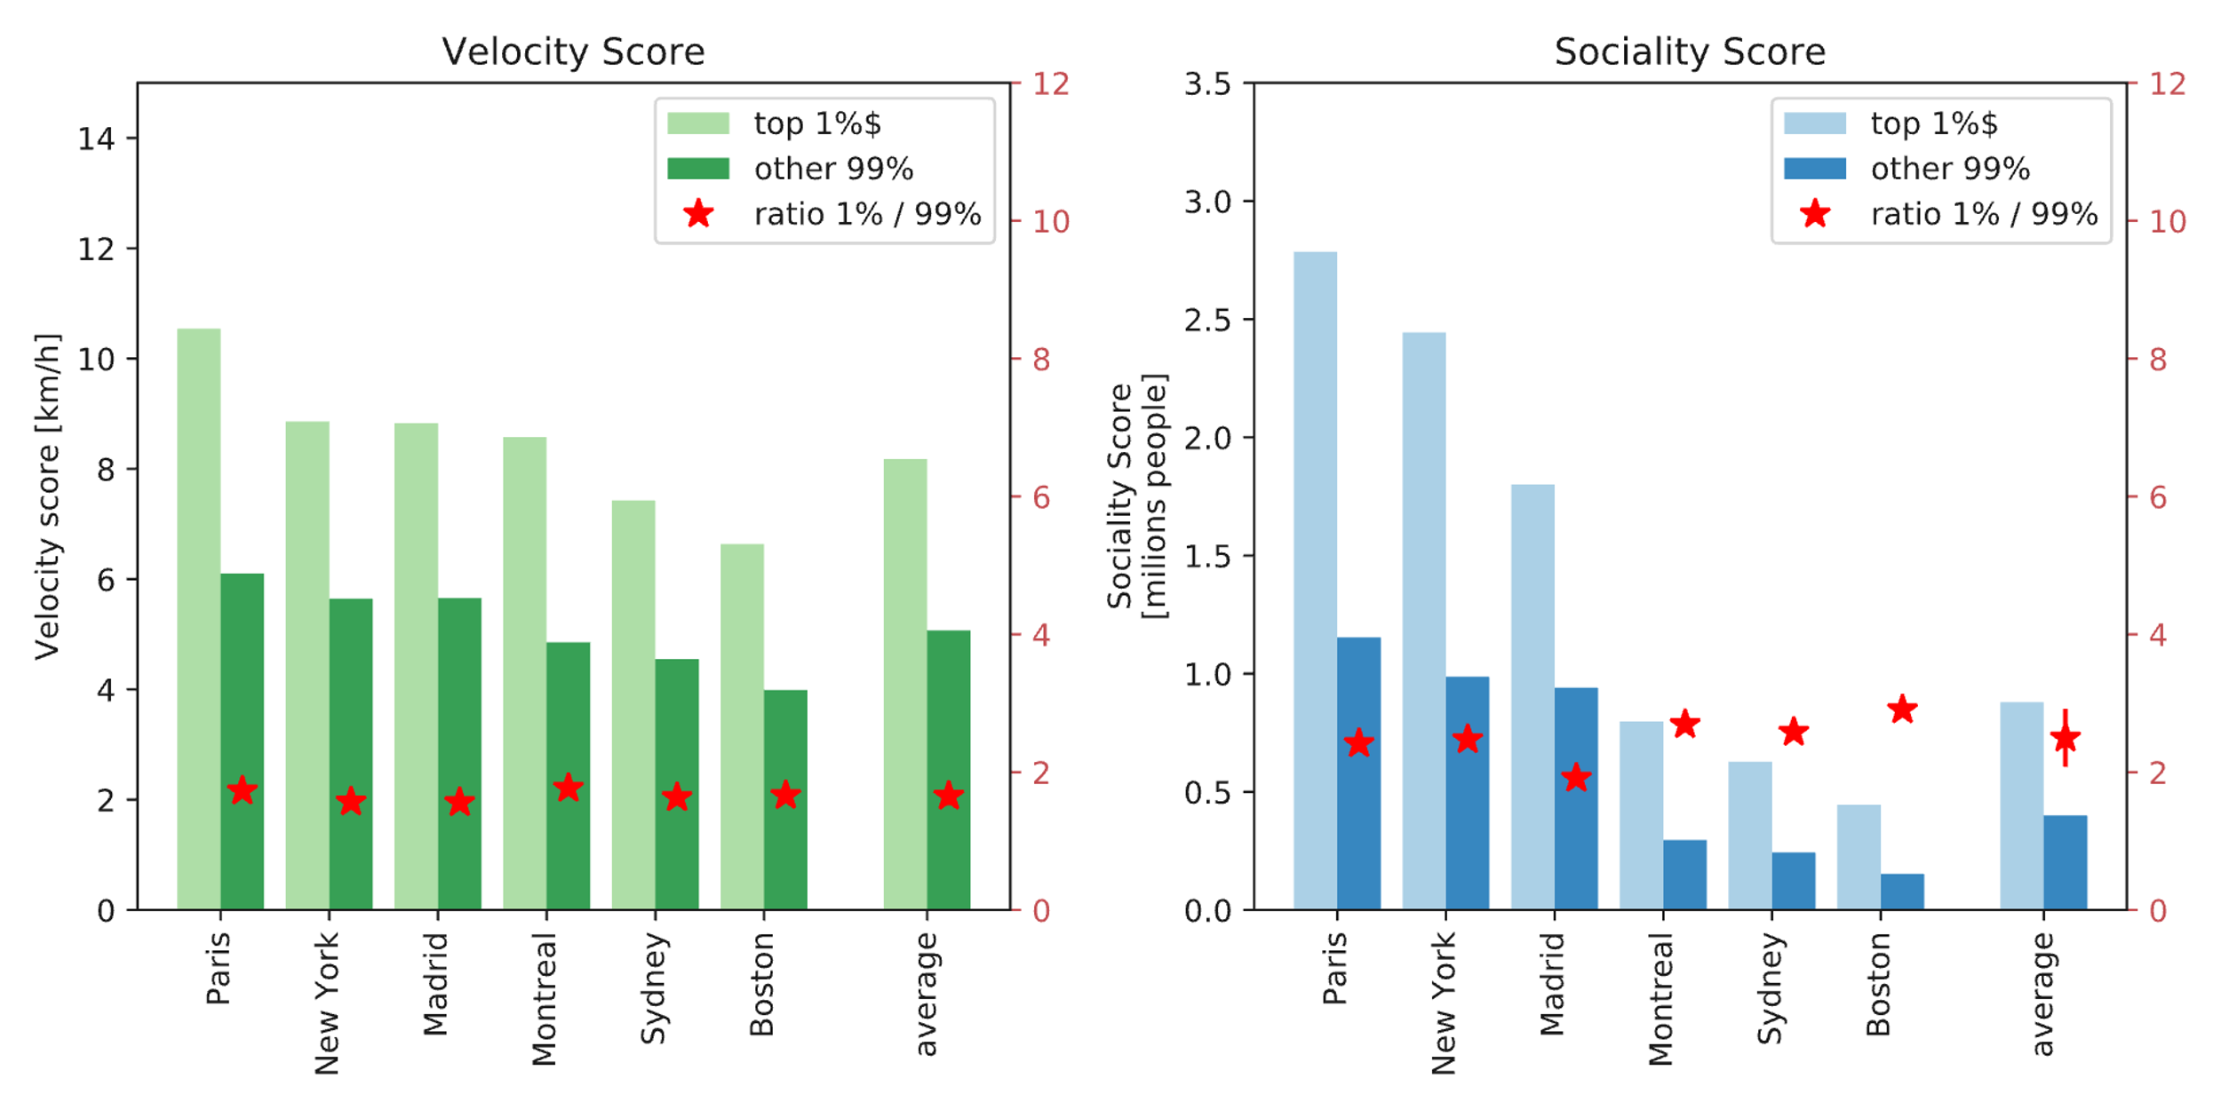
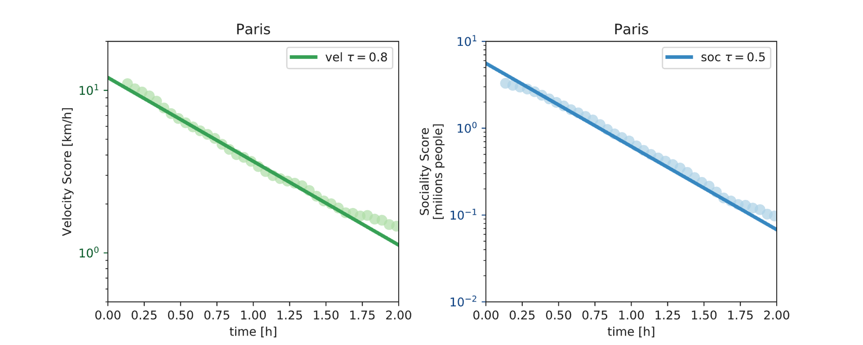
Inequality distribution
Spatial Distributions
Biazzo, I., Monechi, B., & Loreto, V. (2019). General scores for accessibility and inequality measures in urban areas. Royal Society open science, 6(8), 190979.

Slide 8
Can be modified or optimized? The CityChrone Platform

Slide 9
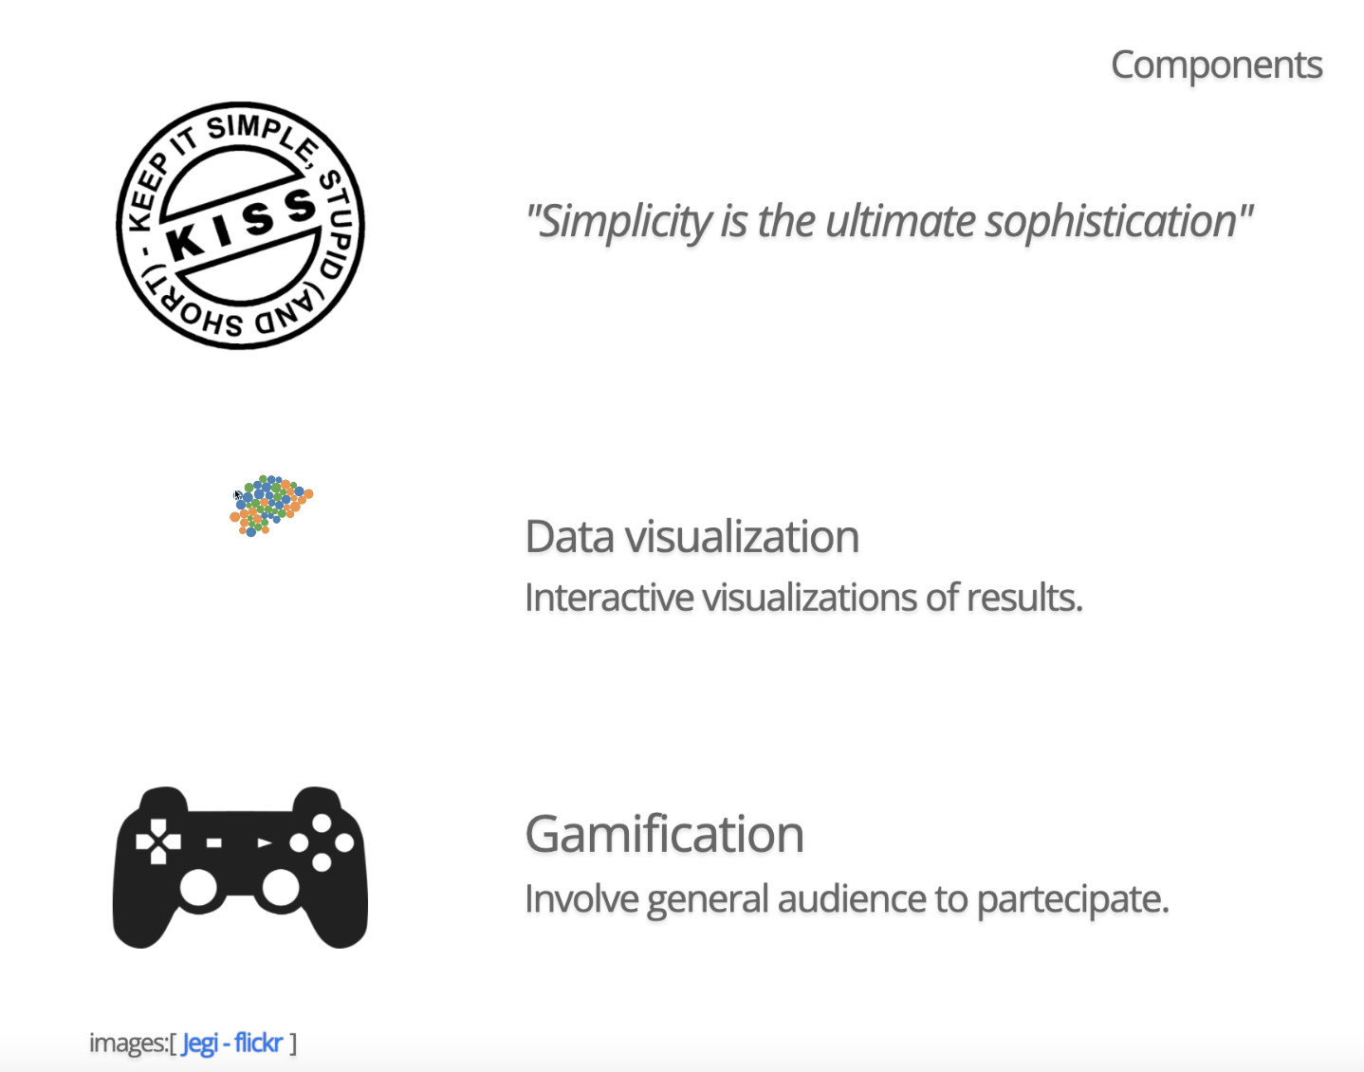
CityChrone interactive platform for transport network analysis and planning in urban systems

Slide 10
Video…

Slide 11
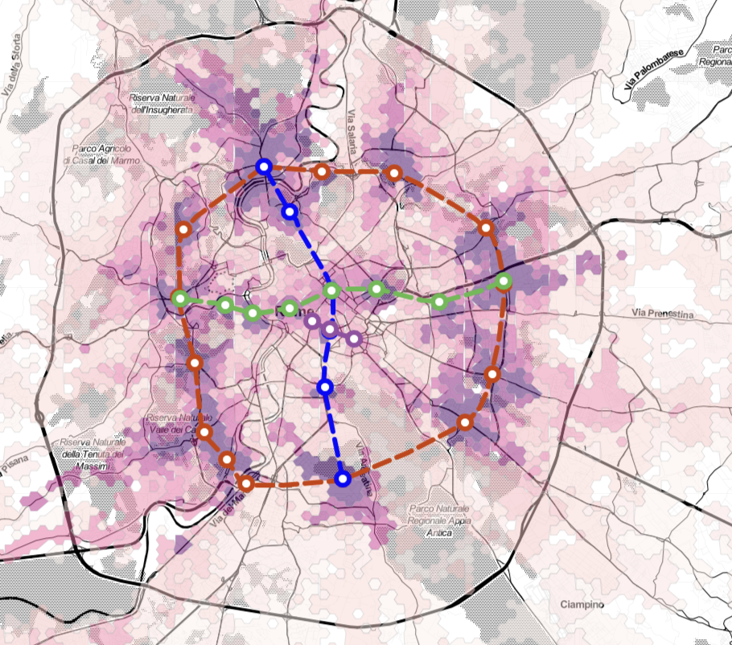
Best Scenario for Rome budget limit: 5 Bilion €
Title: rer+circle
Author: mat

Slide 12
Clustering users’ scenarios

Slide 13
Conclusions
Measure performance of public transports in urban systems.
Interactive platform for disseminating the results and enhance the awareness.
Involve citizen to imagine new public transports scenario.
Using users intelligence and computational resources to solve a very complex optimization problems
Ongoing: heuristics algorithms to find the best metro lines given punctual measures of performances.

